Slide 1

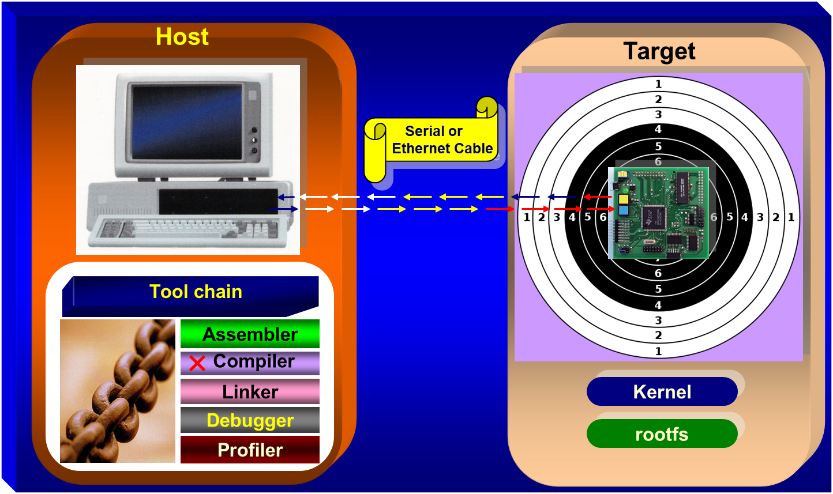

CS 513 Software Systems / VL 506 System Software
Prof. B Thangaraju

Slide 2
Marks Distribution
CS 513 Software Systems (2 credit) | Marks (%)
Mid Term Exam | 50
Hands-on List 1 | 15
Hands-on List 2 | 15
Mini Project | 20
Total | 100

Slide 3
Agenda
1: Computer Architecture
Basic structure of computer hardware and software
Process, Memory and I/O systems: CPU, RAM, Virtual Memory, I/O devices
Types of System - Server, Desktop, Embedded and Real Time
Operating System Vs Kernel
2. Kernel Architecture
Kernel Subsystems (computing resource management)
Types of Kernel: Monolithic, Micro and Hybrid Architecture
Monolithic - Server and Desktop
Microkernel - Embedded and Real Time systems
Hybrid - Handle both RT and Non-RT tasks
3. System Internals
Brief implementation of - process, file, memory and signal management
Communication Mechanisms - pipe, FIFO, message Q, shared memory
4: Synchronization Mechanisms - File and process
Implementation of Soft Real Time Systems - as per POSIX standard
Application Program Vs Kernel Module

Slide 4
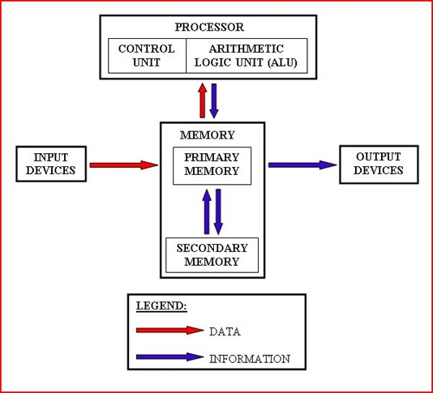
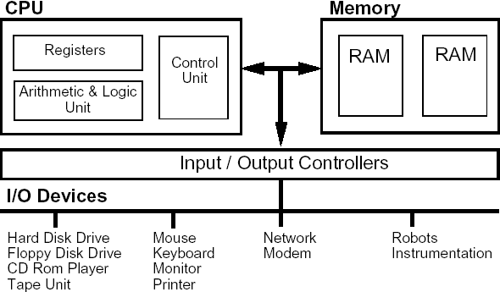
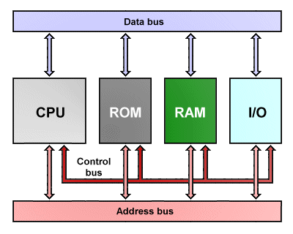
Computer Architecture

Slide 5
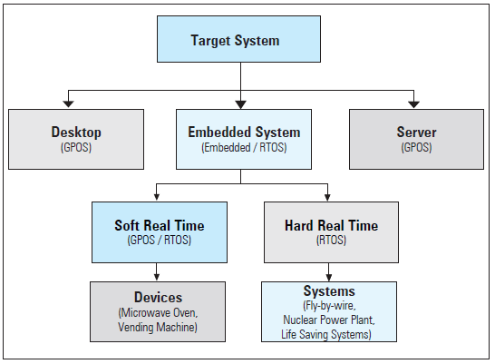
Types of System

Slide 6
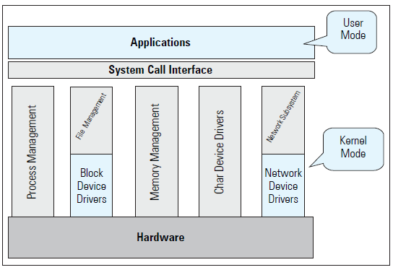
GPOS

Slide 7
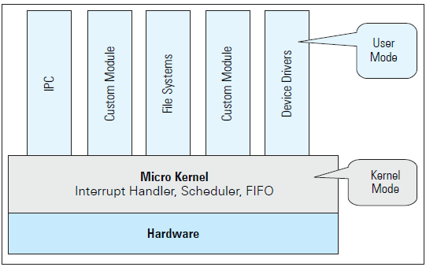
Micro Kernel Architecture

Slide 8






Few Popular RTOS
Master Controller Facility and Antenna Controller System in ISRO
CE, Industrial
and Automotive
Telecom and CE devices
Telecom switches, CE devices
RTLinux
VxWorks
Data Acquisition,
small exchange line cards, Core routers & switches
smart phones
CE Devices

Slide 9
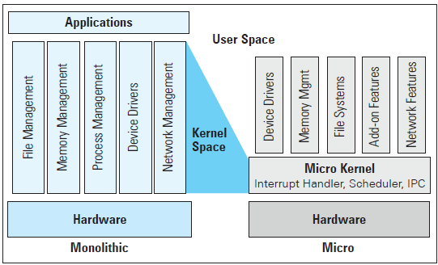
Monolithic Vs Micro Kernel

Slide 10
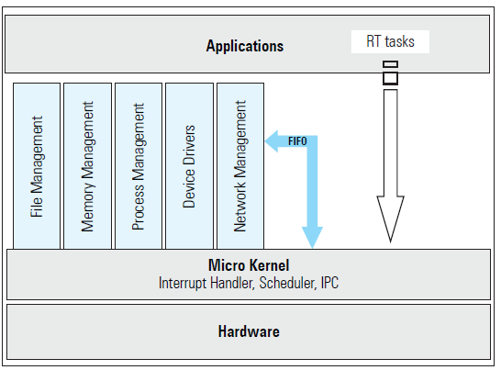
Hybrid Kernel Architecture

Slide 11
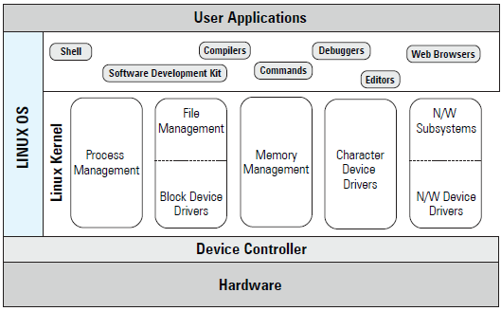
Introduction – Linux OS

Slide 12











































































List of Linux Distributions …not completely
Notes:
Sourceforget.net -> search -> Linux Distribution

Slide 13
Kernel Source Code
The kernel code contains architecture dependent as well as architecture independent code
Machine-independent code deals with
System call handling
The file system: files, directories, pathname translation, file locking, and I/O buffer management
Terminal handling support: the terminal-interface driver and terminal line disciplines
IPC facilities
Network communication support
Machine-dependent code deals with
Low-level system startup functions
Trap and fault handling
Low-level manipulation of runtime context of a process
Configuration and initialization of hardware devices
Runtime support for I/O devices

Slide 14
Booting Procedure
Boot Loader
Extract & decompress kernel
image
Power on
Boot Loader / MBR
Loaded into Physical Memory and uncompressed
Execute Kernel
Mount File Systems (/etc/fstab)
Choose Run Level (/etc/inittab)
Spawn systemd process
Shell / login prompt
Execute kernel
Initialize memory & h/w
Initialize device drivers
Mount root file system
Run systemd script
User programs
login-prompt
Start services
Start X-Windows

Slide 15
Linux Kernel Architecture
System Call Interface
Process
Subsystem
Memory
Subsystem
File
Systems
Device
Control
Network
Subsystem
Concurrency
Virtual
Memory
VFS
tty
access
Connectivity
FS types
Network
layers
Arch
code
Memory
manager
Character
devices
Block devs
Network
drivers
HARDWARE

Slide 16
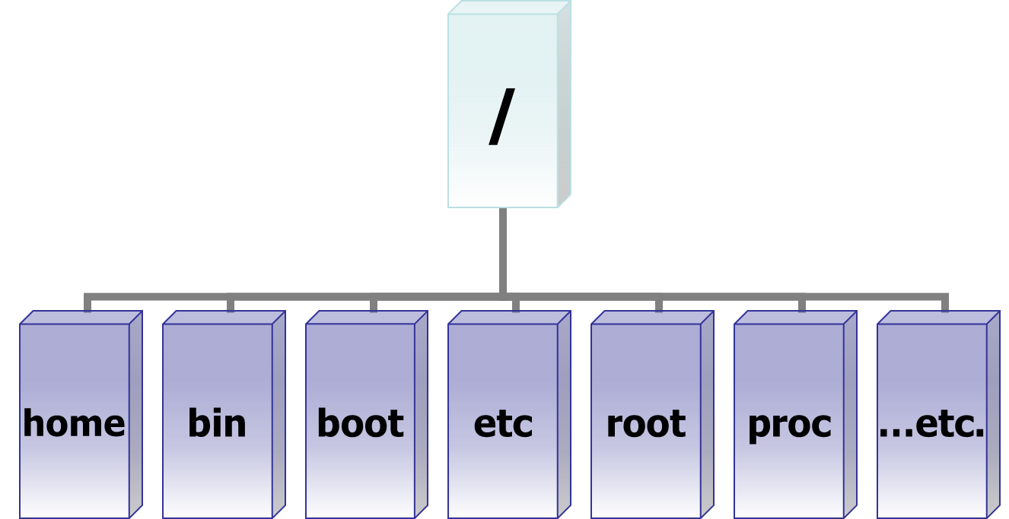
Inverted Tree Structure

Slide 17
File Types
File Types
$lsof /bin/vi - List open files
regular
Directory
Special
Device
Link
Socket
FIFO
Character
Soft
Block
Hard

Slide 18
$ ls -l
Identification of File types
? r w - r- - r- -
?-specifies a type of a file
Regular (-)
Directory (d)
Special Files
Special Files
FIFO (p)
Socket (S)
Link File
Soft Link (l)
Hard Link (inode numbers are same)
Device File
Character (c)
Example: Monitor, Keyboard, Mouse, Tape
Block (b)
Example: Hard disk, CDROM, Floppy

Slide 19
File System
VFS
XFS
ext4
UFS
proc
msdos
iso9660
Vfat
Aufs
…….
Facilitates persistent storage and data management
Facilitates file related system calls.
Different types of file system for different needs –depends on implementation
A logical file system appears as a single entity to the user process, but it may be composed of a number of physical file systems.

Slide 20
File System Architecture
open
write
read
lseek
ioctl
close
0
1
2
fd -> 3
fd Table
Proc File System
3 imp features
Process
System info
System Limitations
Virtual File System (VFS)
XFS
UFS
/ proc
Buffer Cache
UNIX Files
Regular
Directory
Link (Soft and Hard)
FIFO
Socket
Character Device
Block Device
Device Drivers
Physical Devices

Slide 21
ext File System
I-node No
Each I-node entry can track a very large file.
Assuming a block size of 4KB and 12 direct data blocks, a single I-node entry can track file that has a maximum size of:
12 *4 KB +
(1024 * 4 KB) +
(1024*1024 * 4 KB) +
(1024*1024 * 1024 * 4 KB)
File size can grown upto 16 terra bytes.
……….
Block -1 Address
……….
Block -N Address
N direct
Block Address
Single Indirect
Block Address
N single indirect
Block Address
Double Indirect
Block Address
Triple Indirect
Block Address
N double indirect
Block Address

Slide 22
Kilo Vs Kibi
KB Vs KiB
Decimal |  | Binary
Value | Metric | Value | IEC*
10³ (1000) | Kilo | 2¹⁰ (1024) | Kibi
10⁶ | Mega | 2²⁰ | Mebi
10⁹ | Giga | 2³⁰ | Gibi
10¹² | Tera | 2⁴⁰ | Tebi
10¹⁵ | Peta | 2⁵⁰ | Pebi
10¹⁸ | Exa | 2⁶⁰ | Exbi
10²¹ | Zetta | 2⁷⁰ | Zebi
10²⁴ | Yotta | 2⁸⁰ | Yobi
*The International Electrotechnical Commission is a non-profit, non-governmental international standards organization that prepares and publishes International Standards for all electrical, electronic and related technologies – collectively known as "electrotechnology"

Slide 23
FS Comparison

Slide 24
Linux supported File systems ($ man fs )
minix – is the file system used in the Minix OS, the first to run under Linux
ext – is an elaborate extension of the minix file system.
ext2 – is the high performance disk file system used by Linux for fixed disks as well as removable media.
ext3 – is a jounaling version of the ext2 file system.
Reiserfs – is a journaling file system, designed by Hans Reiser.
XFS – is a journaling file system, developed by SGI (Silicon Graphics Inc.)
JFS – is a journaling file system, developed by IBM
msdos – used by DOS and Windows.
umsdos – extended DOS file system.
vfat – extended DOS file system used by Microsoft Windows95 and Windows NT.
proc – pseudo file system, which is used as an interface to kernel data structures. Its files do not take space.
iso9660 – CD-ROM file system type conforming to the ISO 9660 standard.
hpfs – is the high performance File system. This file system is read only under Linux due to the lack of available documentation.
sysv - is an implementation of the SystemV file system.
nfs – is the network file system to access disks located on remote computers.
smb- is a network file system that supports the SMB protocol, used by Windows and Windows NT
ncpfs – is a network file system that supports the NCP protocol, used by Novell NetWare.
Comparison of files systems with various features you can get it from : http://en.wikipedia.org/wiki/Comparison_of_file_systems

Slide 25
XFS File System
When you create a file system, Linux creates a number of blocks on that device.
Boot Block
Super-block
I-node table
Data Blocks
Linux also creates an entry for the “/” (root) directory in the I-node table, and allocates data block to store the contents of the “/” directory.
The super-block contains info. such as
a bitmap of blocks on the device, each bit specifies whether a block is free or in use.
the size of a data block
the count of entries in the I-node table
the date and time when the file system was last checked
B
S
inode table
Data blocks
To get file system information:
$sudo dumpe2fs /dev/sda1
To get superblock information:
$sudo dumpe2fs /dev/sda1 | grep -i superblock

Slide 26
XFS File System
Each device also contains more than one copy of the super-block.
Linux maintains multiple copies of super-block, as the super-block contains information that must be available to use the device.
If the original super-block is corrupted, an alternate super-block can be used to mount the file system.
The I-node table contains an entry for each file stored in the file system. The total number of I-nodes in a file system determine the number of files that a file system can contain.
When a file system is created, the I-node for the root directory of the file system is automatically created.
Each I-node entry describes one file.

Slide 27
XFS File System
Each I-node contains following info
file owner UID and GID
file type and access permissions
date/time the file was created, last modified, last accessed
the size of the file
the number of hard links to the file
Each I-node entry can track a very large file
Ordinary file creation
The kernel allocates space in the hard disk. The text in the file is stored one character per byte of memory.
The file holds these characters and nothing more. It does not contain any information about its beginning or ending.
An inode entry is created on a section of the disk.

Slide 28
Device Special File
A device special file describes following characteristics of a device
Device name
Device type (block device or character device)
Major device number (for example ‘2” for floppy, “3” for hard-disk )
Minor device number (such as “1” for “hda1”)
Switch Table - Unix kernel maintains a set of tables using the major device numbers.
The switch table is used to find out which device driver should be invoked
For example : fd –> file table –> inode table –> switch table –> device drivers

Slide 29
$mount Command
Each file is located on a file system.
Each file system is created on a device, and associated with a device special file.
Therefore, when you use a file, Unix can find out which device special file is associated with that file and send your request to corresponding device driver.
Each file system must be mounted before it can be used. Normally, all file systems are mounted during system startup depending on /etc/fstab entry
(blkid, lsblk, lsblk –help)
root file system is mounted by default
It is possible to mount a file system at any time using the “mount” command.

Slide 30
$mount Command
The “dev” directory contains names of each device special file.
Each file system has a “/” (root) directory. However, once a file system is mounted, it’s the root directory that is accessed through mount point.
A file system is mounted typically under an empty directory. This directory is called the “mount point” for the file system.
When a file system is mounted, the system reads the I-node table and the super-block into memory.
The in-memory I-node table is used when a process tries to access a file.
If kernel does not find an entry in this I-node table, it reads the I-node from the on-disk I-node table into in-memory I-node table.
File system can be unmounted using umount cmd
You can use mount command to find how many file systems are mounted, and what is the mount point for each file system :
Screen shot of mount command
$ mount
/dev/sda6 on / type ext4 (rw)
none on /proc type proc (rw)

Slide 31
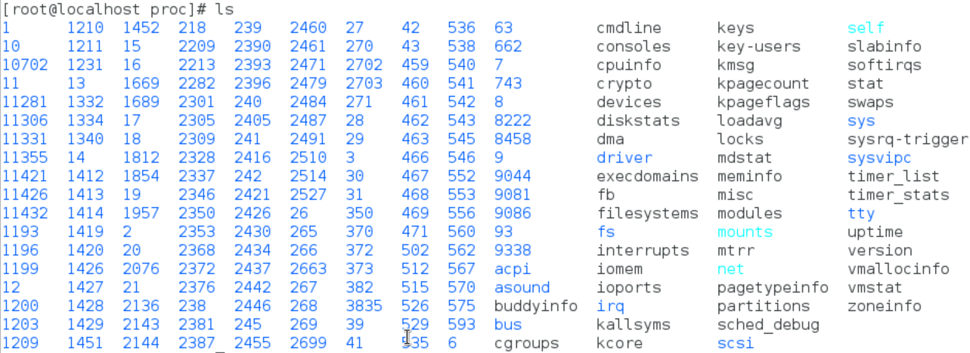
procfs
To store necessary information about currently running processes, system information and limitations. Size of /proc is zero. Created on the fly.

Slide 32
Buffer Cache
The file system also maintains a buffer cache.
The buffer cache is stored in physical memory (non-paged memory).
The buffer cache is used to store any data that is read from or written to a block-device such as a hard-disk, floppy disk or CD-ROM.
It reduces disk traffic and access time
If data is not present in buffer cache
the system allocates a free buffer in buffer cache
reads the data from the disk
stores the data in the buffer cache.
If there is no free buffer in the buffer cache
the system selects a used buffer
writes it to the disk
marks the buffer as free
allocates it for the requesting process.
While all this is going on, the requesting process is put to wait state.
Once a free buffer is allocated and data is read from disk into buffer cache, the process is resumed.
A process can use the sync() system call to tell the system that any changes made by itself in the buffer cache must be written to the disk.

Slide 33
I/O Handling
overview
fd table
System Calls
Opening a file
Duplicating a file descriptor
Random Access
File control
Get file status
select system call

Slide 34
Overview –I/O
The basic model of I/O system is a sequence of bytes that can be accessed either randomly, or sequentially.
There are no file formats (sequential, indexed etc.) and no control blocks (such as a file control block) in a typical user process.
The I/O system is visible to a user process as a stream of bytes (I/O stream). A Unix process uses descriptors (small unsigned integers) to refer to I/O streams.
The system calls related to the Input-Output operations take a descriptor as an argument.
Each process has a separate File Descriptor (FD) Table.
Valid file descriptor ranges from 0 to a maximum descriptor number that is configurable. (ulimit, /proc/sys/fs/file-max)
Kernel assigns descriptors for standard input (0), standard output (1) and standard error (2) of the FD table as part of process creation.
Kernel always assign minimum possible value from the fd table to any new file descriptors.
The system calls related to the I/O system take a descriptor as an argument to handle a file.
The descriptor is a positive integer number.
If a file open is not successful, fd returns -1.

Slide 35
fd Table
fd table
fd table Process 1
fd table Process 2
0 - stdin
0 - stdin
0 - stdin
1 - stdout
1 - stdout
1 - stdout
2 - stderr
2 - stderr
2 - stderr
3 - file1
3 - file1
File 1
3 - file1
4 - file2
4 - file2
4 - file3
File 2
File 3

Slide 36
Interaction between fd and Data Block

Slide 37
User Process Accessing Device Special File

Slide 38
System Calls
File descriptor table (fd, process specific)
File table (offset, mode,permission, pointer to inode table)
Inode Table (inode number, pointer to Data Block).
Switch table (only for device special files)
Data Block (where a file is stored)
The system call code is physically located in the kernel. The kernel itself is stored in a separate area of memory - which is normally not accessible to the process.
Therefore, the first thing that is required to execute a system call is to change to Kernel Mode - so that the kernel memory can be accessed - this is what the “int 0x80” instruction in system call wrapper function (on Intel) does.
Library Functions (Application Programs)
fopen, fwrite, fread, fclose
System Calls (System Programs)
open, write, read, close
$ausyscall –dump –to get list of system calls
Entry Points (Kernel Programs)
my_open, my_write, my_read, my_release

Slide 39
read(fd, &buff, sizeof(buf))
creat / open
read, write
lseek
close, unlink
dup / dup2
fcntl
stat
select
sync
Return to caller - 10
Library procedure
read
Trap to the kernel - 6
Put code for read in register
5
Increment stack pointer -11
User Space
User program calling read
Call read - 4
Push fd - 3
Push &buf - 2
Push sizeof(buf) -1
9
7
Dispatch
System call
handler
Kernel Space
8
System Call vector table

Slide 40
System Calls
int creat (char *file_name, mode_t mode)
int open(char *file_name, int flags);
int open (char *file_name, int flags,mode_t mode);
Ex: fd = open(“temp”, O_RDWR|O_CREAT, 0744);
dup or dup2 copies the oldfd into the newfd.
int new_fd = dup (old_fd);
int dup2 (int new_fd, int old_fd);
new_fd and old_fd shares: locks, file position and flags.
int write ( int fd, const void *buf, int count); it writes count bytes to the file from the buf.
On success return with: Number of bytes written
0 - indicates nothing was written or -1 on error.

Slide 41
System Calls
int write ( int fd, const void *buf, int count);
it writes count bytes to the file from the buf.
On success return with: Number of bytes written
0 - indicates nothing was written or -1 on error.
int read ( int fd, void *buf, int count);
It reads count bytes from the file and store the data into the buf.
On success return with: Number of bytes read
0 - indicates end of the file or -1 on error.
int lseek (int fd, long int offset, int whence);
whence: SEEK_SET, SEEK_CUR or SEEK_END – from the end of file
On success the system call returns with any one of the following value:
Offset value or 0 or -1

Slide 42
System Calls
int stat (“file_name”, struct stat *);
int fstat (fd, struct stat *);
int lstat (“file_name”, struct stat *);
Select is a system call used to handle more than one file descriptor in an efficient manner.
int select (int n, fd_set *readfds, fd_set *writefds, fd_set *exceptfds, struct timeval *timeout);
fd_set is the file descriptor set, which is an arrays of file descriptors.
FD_CLR (int fd, fd_set *myset); FD_ISSET (int fd, fd_set *myset);
FD_SET (int fd, fd_set *myset); FD_ZERO (fd_set *myset);

Slide 43
I/O subroutine
write modifications to the disk file - void sync (void);
Close a fd - int close (fd);
int unlink(“file_name”) - equivalent to $rm file_name;
Linux uses internal routines for accessing a file. For example
namei() (convert a “file_name” into an inode)
iget() (reads an I-node)
iput() (writes an I-node)
bread() (read a block from buffer cache/disk)
bwrite() (write a block from buffer cache to disk)
getblk() (get a free block in the buffer cache)

Slide 44
File Locking
Share data in a file
Concurrent access
Race condition
Dead Lock
Synchronization
File locking

Slide 45
Types of Locking
Two Types
Mandatory locking
Lock an entire file
Advisory (or ) Record locking
Lock to specific byte range
Granularity
Improve Performance

Slide 46
Mandatory Vs Record Locking
p1
p4
p1
p4
READ
WRITE
READ
WRITE
1 Sec
1 Sec
1 Sec
1 Sec
READ
FILE
p2
p2
READ
WRITE
Processes
Operating
on different
Records
1 Sec
WRITE
p5
1 Sec
READ
p5
READ
1 Sec
1 Sec
p3
1 Sec
p3
1 Sec
Total Time = 1 + 1 +1= 3 sec
Total Time = 1 sec

Slide 47
flock Structure
struct flock {
short l_type;
/* lock type: read, write or unlock */
short l_whence;
off_t l_start;
off_t l_len;
pid_t l_pid;
};
Read lock: allows many readers but not a single writer
Write lock: allows only one writer but not a single reader
Lock or unlock is performed by fcntl function.
int fcntl (int fd, int cmd, struct flock &);
Command may be:
F_SETLKW
F_SETLK
F_GETLK

Slide 48
Non-Shared Lock –Mandatory File Locking

Slide 49
Shared Lock – Mandatory File Locking

Slide 50
Shared Lock – Advisory or Record Locking

Slide 51
Sketch of File Locking Implementation

Slide 52
Process Management
mode and space
Context switch
Per process objects
Execution Context
Process structure
Process states
Process scheduling
Process Creation - fork
execl family of Library functions

Slide 53
Introduction
Process is a program in execution.
Processes carry out tasks in a system
A process includes program counter (PC), CPU registers and process stacks, which contains temporary data.
Linux is a multiprocessing system
The Linux kernel is reentrant
A process uses many resources like memory space, CPU, files, etc., during its lifetime.
Kernel should keep track of the processes and the usage of system resources.
Kernel should distributes resources among processes fairly.
Most important resource is CPU. In a multiprocessing environment, to attain an ideal performance of a system, the CPU utilization should be maximum.

Slide 54
Context Switch
In order to run Unix, the computer hardware must provide two modes of execution
kernel mode
user mode
Some computers have more than two execution modes
eg: Intel processor. It has four modes of execution.
Each process has virtual address space , references to virtual memory are translated to physical memory locations using set of address translation maps.
Execution control is changing from one process to another.
When a current process either completes its execution or is waiting for a certain event to occur, the kernel saves the process context and removes the process from the running state.
Kernel loads next runnable process’s registers with pointers for execution.
Kernel space: a fixed part of virtual address space of each process . It maps the kernel text and data structures.

Slide 55
Execution Context
Kernel functions may execute either in process context or in system context
User code runs in user mode and process context, and can access only the process space
System calls and signals are handled in kernel mode but in process context, and may access process and system space
Interrupts and system wide tasks are handled in kernel mode and system context, and must only access system space
Every process is represented by a task_struct data structure.
This structure is quite large and complex.
When ever a new process is created a new task_struct structure is created by the kernel and the complete process information is maintained by the structure.
When a process is terminated, the corresponding structure is removed.
Uses doubly linked list data structure.

Slide 56
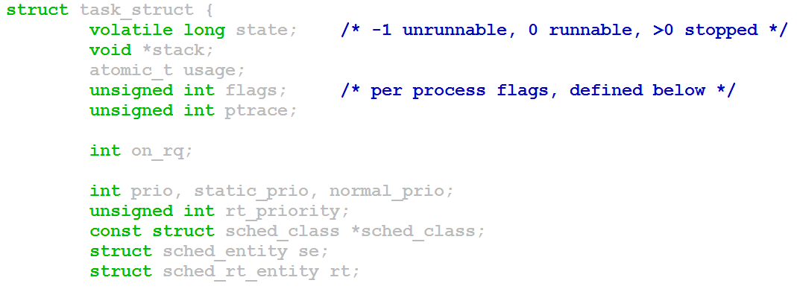
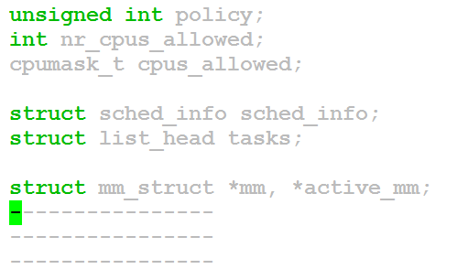
Task_struct Structure - /usr/src/linux-4.12/include/linux/sched.h

Slide 57
Process States
$ls -> fork() -> child process-> exec(“ls”)-> ret. Parent
Running
(User Mode)
Run Queue
Running
(Kernel)
Zombie
fork ( )
exit
TASK_RUNNING
TASK_INTERRUPTIBLE
TASK_UNINTERRUPTIBLE
TASK_STOPPED
TASK_ZOMBIE
Wake up
Sleeping
or
Stopped

Slide 58
Scheduling
Every process in the system has a process identifier.
The process identifier is not an index into the task vector, it is simply a number.
Each process also has User and Group identifiers, these are used to control the process access to the files and devices in the system
The kernel keeps track of a processes creation time as well as the CPU time that it consumes during its lifetime.
This clock is the combination of software and hardware setup.
It is independent of CPU frequency.
A clock tick unit is Jiffy. System‘s interactive response depends on the clock frequency.
For example: the jiffy value may be 10ms (100Hz) or 1ms (1000Hz) depending on implementation

Slide 59
Process Scheduling
Each clock tick, the kernel updates the amount of time that the current process has spent in system and in user mode.
Linux also supports process specific interval timers, processes can use system calls to set up timers to send signals to themselves when the timers expire. These timers can be single-shot or periodic timers.
The job of a scheduler is to select the most deserving process to run out of all of the runnable processes in the run queue.
Implement fair scheduling to avoid starvation
Implement suitable scheduling policy
Updates state of the processes in every clock tick (jiffy)

Slide 60
Process Scheduling
policy - FIFO, Round Robin, Shortest Job First, FILO, Priority based etc.
priority - higher priority process will be allowed to run.
Pre-emptive and Non-preemptive scheduling
rt_priority – many UNIX variants support real time scheduling priority range.
The Linux kernel implements two separate priority ranges.
The first is the nice value, a number from -20 to 19 with a default of zero. Larger nice values correspond to a lower priority.
A process with a nice value of -20 receives the maximum time slice, whereas a process with a nice value of 19 receives the minimum time slice.
Time slice: minimum -10ms, default -150ms and maximum – 300ms

Slide 61
Process Scheduling
The second range is the real-time priority
By default, it ranges from zero to 99.
All real time processes are at a higher priority than normal processes.
Linux implements real-time priorities in accordance with POSIX.
Linux provides two real-time scheduling policies, SCHED_FIFO and SCHED_RR.
The normal non real-time scheduling policy is SCHED_OTHER.
SCHED_FIFO implements without time slices- so it can run until it blocks or explicitly yields the processor.
SCHED_RR is identical to SCHED_FIFO except that each process can only run until it exhausts a predetermined time slice.

Slide 62
Linux Scheduling Priority
Real Time
Non - Real Time
SCHED_FIFO
SCHED_RR
SCHED_OTHER
0
99
139
FIXED
DYNAMIC
Non - Real Time Process
Priority
-20
0
+19
Priority
300 ms
150 ms
10 ms
Time Slice

Slide 63
Linux Scheduling Priority
HIGER PRIORITY
LOWER PRIORITY
0
1
50
70
88
98
100
139
138
139
SYSTEM PRIORITY
99
98
3
0
REAL TIME PRIORITY
-20
0
19
NICE LEVEL
RT
-98
-80
-55
-5
0
38
39
$top OUTPUT

Slide 64
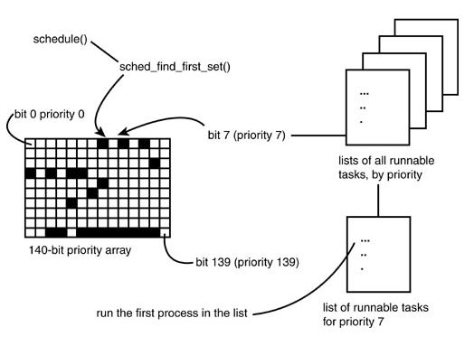
O(1) Scheduler
Ref: Linux Kernel Development by Robert Love

Slide 65
nice and chrt –Manipulate Scheduling Priorities
Command Priority nice
$nice -19 ./a.out 39 19
$nice -10 ./a.out 30 10
$nice -20 ./a.out
$renice –n 5 –p <pid>
xyz (process ID) old priority 19, new priority 5
$renice –n -20 –p <pid>
Old priority 5, new priority -20
In top command: PR – 0; NI = -20
Command Priority nice
$chrt -r –p -1 <pid> < NOT VALID COMMEND>
$chrt -r –p 0 <pid> 20 0
$chrt -r –p 1 <pid> -2 0
$chrt -r –p 5 <pid> -6 0
$chrt -r –p 50 <pid> -51 0
$chrt -r –p 90 <pid> -91 0
$chrt -r –p 98 <pid> -99 0
$chrt -r –p 99 <pid> RT 0
$chrt -r –p 100 <pid> < NOT VALID COMMEND>

Slide 66
Process Scheduling Commands
$nice -19 ./***.sh; top ;
r -> pid to renice; renice value: 10
$man chrt (1)
$chrt –m
Show minimum and maximum valid priorities.
$chrt -p <pid>
To display scheduling attributes of an existing task
$chrt -r -p 99 <pid>
Set scheduling policy to SCHED_RR
$ top -p <pid>
$chrt -f -p 99 <pid>
Set scheduling policy to SCHED_FIFO
$chrt -o -p 0 <pid>
Set scheduling policy to SCHED_OTHER
man 2 sched_setscheduler

Slide 67
System Calls for Scheduling
nice() Set a process's nice value
sched_setscheduler() Set a process's scheduling policy
sched_getscheduler() Get a process's scheduling policy
sched_setparam() Set a process's real-time priority
sched_getparam() Get a process's real-time priority
sched_get_priority_max() Get the maximum real-time priority
sched_get_priority_min() Get the minimum real-time priority
sched_rr_get_interval() Get a process's timeslice value

Slide 68
Process Creation
A Command is normally executed in a shell
When you enter a command, the shell searches the corresponding command’s executable image (use PATH environment variable) and loads the image then executes.
For execution, the shell uses fork and creates a new child process and the child process’s image is replaced with the command’s executable image.
After completion of execution of the child process it gives the exit status to the parent process, i.e, shell.
Resources
Data
Resources
Text
Stack
Process Status
File
File
Linux kernel

Slide 69
Process Tree Structure
In a Linux system no process is independent of any other process.
Every process in the system, except the initial process has a parent process.
New processes are not created, they are copied, or cloned from previous processes.
Every task_struct representing a process keeps pointers to its parent process and as well as to its own child processes
$pstree – process tree structure shows the process dependency.
Parent process creates children processes, which, in turn create other processes, forming a tree of processes.
Resource sharing
Parent and children share all resources.
Children share subset of parent’s resources.
Parent and child share no resources.
Execution
Parent and children execute concurrently.
Parent waits until children terminate.
Address space
Child duplicate of parent.
Child has a program loaded into it.

Slide 70
Parent and Child
if (!fork) {
/* Child Code */
}
else {
/* parent code */
wait (0); /* or */
waitpid(pid, ….);
}
pid_t fork (void); creates a new process
All statements after the fork() system call in a program are executed by two processes - the original process that used fork(), plus the new process that is created by fork( )
main ( ) {
printf (“ Hello fork %d\n, fork ( ) ”);
}
Hello fork: 0
Hello fork: x ( > 0);
Hello fork: -1

Slide 71
COW, Zombie and Orphan Process
Instead of copying the address space of the parent, Linux uses the COW technique for economical use of the memory page.
The parent space is not copied, it can be shared by both the parent and the child process but the memory pages are marked as write protected.
if parent or child wants to modify the pages, then kernel copies the parent pages to the child process.
Advantage: Kernel can defer or prevent copying of a parent process address space.
When a child process exits, it has to give the exit status to the parent process.
If the parent process is busy or suspended then the child process will not be able to terminate.
Such state is called Zombie.
if parent exits before child, the child will become an orphan process and the init process (grand parent) will take care of the child process.

Slide 72
exec Family of Functions
To run a new program in a process, you use one of the “exec” family of calls (such as “execl”) and specify following:
the pathname of the program to run, the name of the program
each parameter to the program
(char *)0 or NULL as the last parameter to specify end of parameter list
int execl (const char *path, const char *arg, …..);
int execlp (const char *file, const char *arg);
int execle (const char *path, const char *arg, ……., char *const envp[ ]);
int execv (const char *path, char *const argv[ ]);
int execvp (const char *file, char *const argv[ ]);
All the above library functions call internally execve system call.
int execve (const char *filename, char *const argv [ ] , char *const evnp [ ]);

Slide 73
An Executable Image
The text portion of a process contains the actual machine instructions that are executed by the hardware.
When a program is executed by the OS, the text portion is read into memory from its disk file, unless the OS supports shared text and a copy of program is already being executed.
Stack
Heap
Uninitialised data
The data portion contains the program’s data. It is possible for this to be divided into 3 pieces
Initialized read only data contains elements that are initialized by the program and are read only while the process is executing.
Initialized read write data contains data elements that are initialized by the program and may have their values modified during execution of the process.
Un-initialized data contains data elements that are not initialized by the program but are set to zero before execution starts .
Initialized read-write data
Initialized Read-only data
Text
$ size a.out (man size )
text data bss dec hex filename
920 268 24 1212 4bc a.out

Slide 74
Stack Portion
The heap is used while a process is running to allocate more data space dynamically to the process.
The stack is used dynamically while the process is running to contain the stack frames that are used by many programming languages.
The stack frames contain the return address linkage for each function call and also the data elements required by a function.
A gap is shown between heap and stack to indicate that many OS leave some room between these 2 portions, so that both can grow dynamically.
The kernel context of a process is maintained and accessible only to the kernel. This area contains info that the kernel needs to keep track of the process and to stop and restart the process while other processes are allowed to execute.

Slide 75
Daemon Process
Daemon process starts during system startup
They frequently spawn other process to handle services requests
Mostly started by initialization script /etc/rc
Waits for an event to occur
perform some specified task on periodic basis (cron job)
perform the requested service and wait
Example print server
executed as the background process
Orphan process
No controlling terminal
run with super user privileges
process group leaders
session leaders

Slide 76
Daemon Process Creation
Process Types
Parent
Child
Orphan
Daemon
int init_daemon ( void ) {
if ( ! fork ( ) ) {
setsid ( ) ;
chdir ( " / " ) ;
umask ( 0 ) ;
/* Specify Your Job */
return ( 0 );
}
else
exit ( 0 );
}
Process States
Running (R)
Stopped (T)
Sleep
Interruptible (S)
Uninterruptible (D)
Zombie (Z)

Slide 77
Inter Process Communications (IPC) Mechanisms
In a multiprocessing environment, often many processes are in need to communicate with each other and share some of the resources.
The shared resources must also be synchronized from the concurrent access by many processes.
IPC mechanisms have many distinct purposes: for example
* Data transfer * Sharing data
* Event notification * Resource sharing
* Process control
Primitive
Unnamed pipe
Named pipe (FIFO)
System V IPC
Message queues
Shared memory
Semaphores
Socket Programming

Slide 78
Pipe Example
Client - Server
STDIN
Path Name
Client
Server
File
STDOUT
File Content or Error
Message

Slide 79
pipe (or unnamed pipe “|”)
On command line pipe is represented as “|”
It can be used in the shell to link two or more commands
For example ls –Rl | wc
Two ends of a pipe is represented as a set of two descriptors.
A pipe is used to communicate between related processes.
Half duplex
Data is passed in order.
Pipe uses circular buffer and it has zero buffering capacity
The read and write system calls are blocking calls.

Slide 80
Pipe – half duplex
read
fd[0]
write
fd[1]
int fd[2];
pipe(fd);
-returns with fd[0], fd[1];
write(fd[1], …………);
read(fd[0], ……….);
Create a pipe.
Call fork.
Parent can send data and child can read the data or vice versa.
Unused ends (descriptors) should be closed.

Slide 81
One way data transfer from related process
One-way communication from parent to child
fd[0] fd[0]
read
Close read end
Child
process
pipe
Parent
process
write
Close write end
fd[1]
fd[1]

Slide 82
Two Way Communication
Create two pipes say fd1, fd2.
Four descriptors for each process (fd1[0], fd1[1], fd2[0], fd2[1]).
Parent closes read end of fd1 and write end of fd2 close(fd1[0], fd2[1]);
child closes read end of fd2 and write end of fd1 close(fd2[0], fd1[1]);
Child
Parent
fd1[1]
fd1[0]
pipe1
pipe2
fd2[0]
fd2[1]

Slide 83
Execution of command: $ ls –Rl | grep ^d | wc -l
Ls –Rl
grep ^d
wc -l
Stdin
Stdout
Stdin
Stdout
Process
kernel
Pipe advantages:
Simplest form of IPC
Persistence in process level
Can be used in shell
Disadvantages:
Cannot be used to communicate between unrelated processes
Pipe1
Pipe2
Flow of data
Flow of data

Slide 84
popen ( ) Library Function
The popen library function opens a process by creating a pipe, execute fork and invoke a shell.
FILE *popen (const char *executable, const char *mode);
On success returns file pointer else NULL (if fork or pipe system calls failed).
int pclose (FILE *STREAM);
Used to read or write to a file at a specified offset value.
Same as read/write except the starting position is from the given offset.
On success the system calls return number of bytes read or written.
If 0 returns
pwrite: nothing has been written
pread: end of file

Slide 85
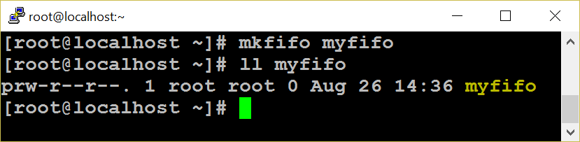
FIFO -Introduction
FIFO can be created in a shell by using mknod or mkfifo command.
mknod myfifo p
mkfifo a=rw myfifo
In a C program mknod system call or mkfifo library function can be used.
int mkfifo ( char *file_name, mode_t mode);
int mknod (char *file_name, mode_t mode, dev_t dev);
mknod(“./MYFIFO", S_IFIFO|0666, 0);
FIFO works much like a pipe
Half duplex, data passed in FIFO order, circular buffer and zero buffering capacity.
FIFO is created on a file system as a device special file
It can be used to communicate between unrelated processes
It can be reused.
Persist till the file is deleted.

Slide 86
FIFO
Once a FIFO is created, you can use file’s related system calls (open, read, write, select, close etc., ) to access the FIFO.
For example: Process 1 may open a FIFO in write only mode and write some data.
Process 2 may open the FIFO in read only mode, read the data and display on the monitor.
FIFO - Disadvantages
Data cannot be broadcast to multiple receivers.
If there are multiple receivers, there is no way to direct to a specific reader or vice versa.
Cannot store data and you cannot use FIFO across network.
Less secure than a pipe, since any process with valid access permission can access data.
No message boundaries. Data is treated as a stream of bytes.

Slide 87
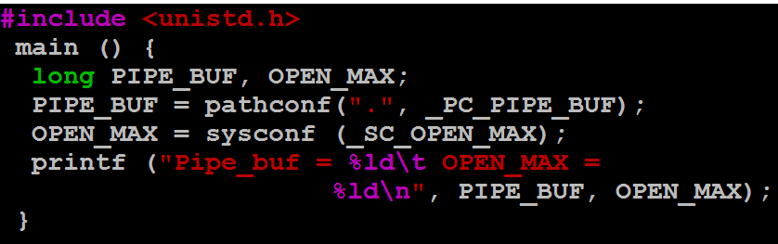
FIFO Limitation
System imposed limits on pipes
Maximum number of files can be open within a process is determined by OPEN_MAX macro.
Maximum amount of data that can be written to a pipe of FIFO atomically is determined by PIPE_BUF macro (size of a circular buffer ).

Slide 88
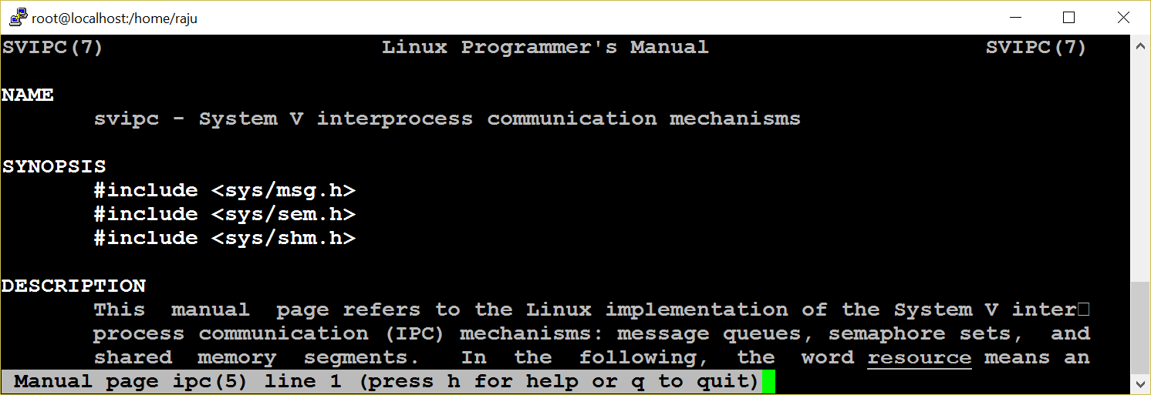
System V IPC
Pipe and FIFO do not satisfy many requirements of many applications.
Sys V IPC is implemented as a single unit
System V IPC Provides three mechanisms namely : MQ, SHM and SEM
Persist till explicitly delete or reboot the system

Slide 89
Attributes
Each IPC objects has the following attributes.
key
id
Owner
Permission
Size
Message queue – used-bytes, number of messages
Shared memory – size, number of attach, status
Semaphore – number of semaphores in a set
The ipc_perm structure holds the common attributes of the resources.
Key:
the first step is to create a shared unique identifier.
The simplest form of the identifier is a number
the system generates this number dynamically by using the ftok library function.
Syntax: key_t ftok (const char *filename, int id);

Slide 90
ID
The syntax for a get function is:
int xxxget (key_t key, int xxxflg);
(xxx may be msg or shm or sem)
If successful, returns to an identifier; otherwise -1 for error.
The key can be generated in three different ways
from the ftok library function
by choosing some static positive integer value
by using the IPC_PRIVATE macro
flags commonly used with this function are IPC_CREAT and IPC_EXCL.
The syntax for the control function is:
int xxxctl (int xxxid, int cmd, struct xxxid_ds *buffer); (xxx may be msg or shm or sem);
If successful, the xxxctl function returns zero, otherwise it returns -1.
The command argument may be
IPC_STAT
IPC_SET
IPC_RMID

Slide 91
Message Q
Message queue overcomes FIFO limitation like storing data and setting message boundaries.
Create a message queue
Send message (s) to the queue
Any process who has permission to access the queue can retrieve message (s).
remove the message queue.
Stuct
msgqid_ds
p
p
Message read from head
New Messages added at tail
msg
msg
msg
p
p

Slide 92
Message Q
struct msgbuf {
long mtype;
char mtext [1];
}; Standard structure
msqid xxx
mtype x₁
msg text
mtype x₂
msg text
mtype x₃
msg text
struct My_msgQ {
long mtype;
char mtext [1024];
void * xyz;
}; Our own structure
mtype x₄
msg text
mtype x₅
msg text
---------
mtype x_{n}
msg text

Slide 93
MQ System Calls
int msgget (key_t key, int msgflg);
The first argument key can be passed from the return value of the ftok function or made IPC_PRIVATE.
To create a message queue, IPC_CREAT ORed with access permission is set for the msgflg argument.
Ex: msgid = msgget (key, IPC_CREAT | 0744);
msgid = msgget (key, 0);
syntax of the function is:
ssize_t msgrcv (int msqid, struct msgbuf *msgp, size_t msgsz, long msgtype, int msgflg);
msgtype argument is used to retrieve a particular message.
0 -retrieve in FIFO order
+ve - retrieve the the exact value of the message type
–ve - first message or <= to the absolute value.
on success, msgrcv returns with the number of bytes actually copied into the message text
The syntax of the function is:
int msgsnd (int msqid, structu msgbuf *msgp, size_t msgsz, int msgflg);
Arguments:
message queue ID, address of the structure.
size of the message text
message flag = 0 or IPC_NOWAIT

Slide 94
MQ System Calls
syntax of the function is:
ssize_t msgrcv (int msqid, struct msgbuf *msgp, size_t msgsz, long msgtype, int msgflg);
msgtype argument is used to retrieve a particular message.
0 -retrieve in FIFO order
+ve - retrieve the the exact value of the message type
–ve - first message or <= to the absolute value.
on success, msgrcv returns with the number of bytes actually copied into the message text
key = ftok (“.“, ‘a‘);
msqid = msgget (key, IPC_CREAT|0666);
msgsnd (msqid, &struct, sizeof (struct), 0);
msgrcv (msqid, &struct, sizeof (struct), mtype, 0);
msgctl (msqid, IPC_RMID, NULL);
$ipcrm msg msqid

Slide 95
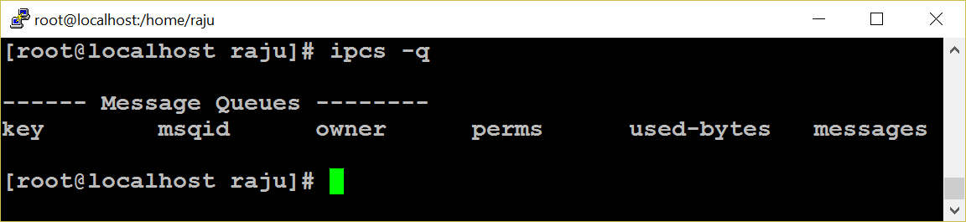
MQ Limitations
Message queues are effective if a small amount of data is transferred.
Very expensive for large transfers.
During message sending and receiving, the message is copied from user buffer into kernel buffer and vice versa
So each message transfer involves two data copy operations, which results in poor performance of a system.
A message in a queue can not be reused

Slide 96
Shared Memory - Introduction
Very flexible and ease of use.
Fastest IPC mechanisms
shared memory is used to provide access to
Global variable
Shared libraries
Word processors
Multi-player gaming environment
Http daemons
Other programs written in languages like Perl, C etc.,
Kernel
shmid
shmid
pointer
Shared Memory Size
Shm size
Physical Memory
shmget( )
shmat( )

Slide 97
Shared Memory
Shared memory is a much faster method of communication than either semaphores or message queues.
Does not require an intermediate kernel buffer
Using shared memory is quite easy. After a shared memory segment is set up, it is manipulated exactly like any other memory area.
The steps involved are
Creating shared memory
Connecting to the memory & obtaining a pointer to the memory
Reading/Writing & changing access mode to the memory
Detaching from memory
Deleting the shared segment

Slide 98
shm – system calls
shmget system call is used to create a shared memory segment.
The syntax:
int shmget (key_t key, int size, int shmflg);
key: the return value of ftok function.
size: size of the shared memory.
shmflg: IPC_CREAT|0744
On success the shmget returns the shared memory ID or else it returns -1.
used to attach the created shared memory segment onto a process address space.
void *shmat(int shmid,void *shmaddr,int shmflg)
Example: data=shmat(shmid,(void *)0,0);
A pointer is returned on the successful execution of the system call and the process can read or write to the segment using the pointer.

Slide 99
shm – system calls
Reading or writing to a shared memory is the easiest part.
The data is written on to the shared memory as we do it with normal memory using the pointers
Example -
Read:
printf (“SHM contents : %s \n”, data);
Write:
printf (“”Enter a String : ”);
scanf (“ %[^\n]”,data);
The detachment of an attached shared memory segment is done by shmdt to pass the address of the pointer as an argument.
Syntax: int shmdt (void *shmaddr);
To remove shared memory call:
int shmctl (shmid,IPC_RMID,NULL);
These functions return –1 on error and 0 on successful execution.

Slide 100
shm –system calls
shmid = shmget (key, 1024, IPC_CREAT|0744);
void *shmat (int shmid, void *shmaddr, int shmflg); if the shm is read only pass SHM_RDONLY else 0
(void *)data = shmat (shmid, (void *)0, 0);
int shmdt (void *shmaddr);
int shmctl (shmid, IPC_RMID, NULL);
Data can either be read or written only. Append ?
Race condition
Since many processes can access the shared memory, any modification done by one process in the address space is visible to all other processes.
Since the address space is a shared resource, the developer should implement a proper locking mechanism to prevent the race condition in the shared memory.

Slide 101

Semaphore
Synchronization Tool
An Integer Number
P ( ) And V ( ) Operators
Avoid Busy Waiting
Types of Semaphore
Used in :
shared memory segment
message queue
file

Slide 102
p and v operations
Incrementing Operations:
int v (int i)
{
i = i + 1; (unlock)
return i;
}
If a process wants to use the shared object, it will “lock” it by asking the semaphore to decrement the counter
Depending upon the current value of the counter, the semaphore will either be able to carry out this operation, or will have to wait until the operation becomes possible
The current value of counter is >0, the decrement operation will be possible. Otherwise, the process will have to wait
Decrementing Operations:
int p (int i) {
if (i > 0)
then
i--; (lock)
else
wait till i > 0;
return i;
}
System V semaphore provides a semaphore set - that can include a number of semaphores. It is up to user to decide the number of semaphores in the set
Each semaphore in the set can be a binary or a counting semaphore. Each semaphore can be used to control access to one resource - by changing the value of semaphore count

Slide 103
Semaphore Implementation
union semun {
int val; // value for SETVAL
struct semid_ds *buf; // buffer for IPC_STAT, IPC_SET
unsigned short int *array; // array for GETALL, SETALL
};
union semun arg;
semid = semget (key, 1, IPC_CREAT | 0744);
arg.val = 1;
/* 1 for binary else > 1 for Counting Semaphore */
semctl (semid, 0, SETVAL, arg);
struct sembuf {
short sem_num; /* semaphore number: 0 means first */
short sem_op; /* semaphore operation: lock or unlock */
short sem_flg; /* operation flags : 0, SEM_UNDO, IPC_NOWAIT */
};
struct sembuf buf = {0, -1, 0}; /* (-1 + previous value) */
semid = semget (key, 1, 0);
semop (semid, &buf, 1); /* locked */
-----Critical section--------
buf.sem_op = 1;
semop (semid, &buf, 1); /* unlocked */

Slide 104
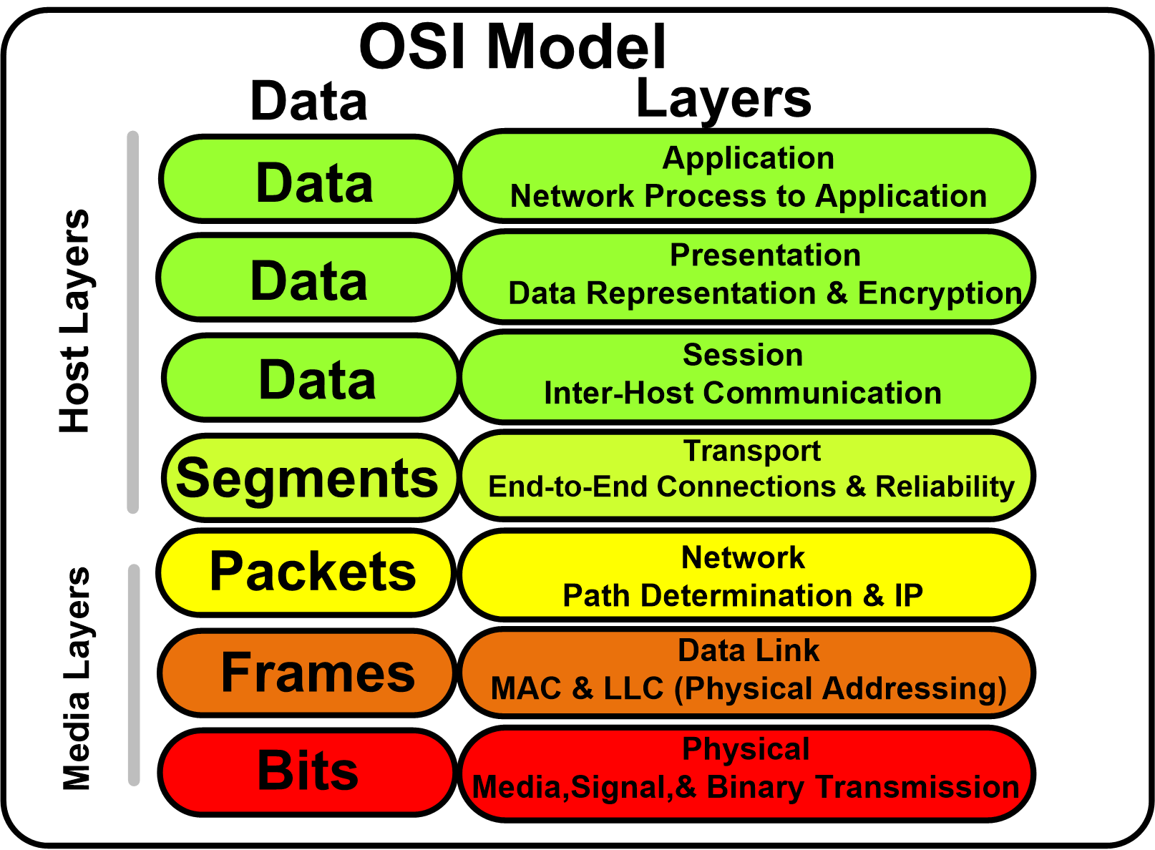
Socket Programming - TCP/IP Protocol Stack
A socket is used to communicate between different machines (different IP addresses). Socket of type SOCK_STREAM is full-duplex byte streams.
Application (telnet/ftp)
Application details
User process
Sockets
Transport Layer
TCP
UDP
Kernel
Network Layer
IP
Device Driver and Hardware
Communication details

Slide 105


Socket Programming – Client Server Model
Client x
Concurrent Server
A socket is a communication endpoint and represents abstract object that a process may use to send or receive messages.
The two most prevalent communication APIs for Unix Systems are Berkeley Sockets and System V Transport Layer Interface(TLI)
Socket Program
Client 1
Server
Client y

Slide 106
socket ( ) system call
The typical client -server relationship is not symmetrical
Network Connection can be connection-oriented or connectionless
More parameters must be specified for network connection, than for file I/O
The Unix I/O system is stream oriented
The network interface should support multiple communication protocol
int socket (int domain,int type,int protocol);
Domain (AF – Address Family)
AF_UNIX for UNIX domain
AF_INET for Internet domain
Socket type
SOCK_STREAM for TCP (Connection Oriented)
SOCK_DGRAM for UDP (Connectionless)
Protocol
Protocol number is used to identify an application. List of the protocol number and the corresponding applications can be seen at /etc/protocols.
The socket system call returns a socket descriptor on success and -1 for failure.

Slide 107
Socket Functions
TCP Server
socket( )
bind( )
listen( )
socket( )
accept( )
connect( )
Connection establishment
Blocks until connection from client
3 way hand shake
write( )
read( )
Request
read( )
write( )
Reply
close( )
read( )
End of file notification
close( )

Slide 108
sock structure
struct sockaddr_in {
short int sin_family;
unsigned short int sin_port;
struct in_addr sin_addr;
}
sin_family - address family
sin_port - port number
sin_addr - internet address (IP addr)
The in_addr structure used to define sin_addr is as under
struct in_addr {
unsigned long s_addr;
/* refers to the four byte IP address */
}
Little endian byte order : example: Intel series
High order byte low order byte
Address A+1
00 01 64 C1
Address A
Increasing memory address
Big endian byte order : example: IBM 370, Motorola
High order byte low order byte
Address A+1
C1 64 01 00
Address A
Increasing memory address
Byte ordering ex: 91,329 hex: 00 01 64 C1

Slide 109
Socket system calls
Internet protocols use big endian byte ordering called network byte order
The following functions allow conversions between the formats.
#include <netinet/in.h>
htons() – "Host to Network Short"
htonl() – "Host to Network Long"
ntohs() – "Network to Host Short"
ntohl() – "Network to Host Long"
h stands for host n stands for network
s stands for short l stands for long
int bind (int sockfd, struct sockaddr *my_addr,int addrlen);
sockfd - the socket file descriptor returned by socket().
my_addr - a pointer to a struct sockaddr that contains information about IP address and port number.
addrlen - set to sizeof (struct sockaddr)

Slide 110
Socket system calls
int connect (int sockfd, struct sockaddr *serv_addr, int addrlen);
sockfd - the socket file descriptor returned by socket().
serv_addr - is a struct sockaddr containing the destination port and IP address.
addrlen - set to sizeof (struct sockaddr).
int listen (int sockfd,int backlog);
sockfd - the socket file descriptor returned by socket().
backlog - the number of connections allowed on the incoming queue.
Backlog should never be zero as servers always expect connection from client.
The listen function converts an unconnected socket into a passive socket,
On successful execution of listen is indicating that the kernel should accept incoming connection requests directed to this socket.

Slide 111
Socket system calls
int accept (int sockfd, void *addr, int *addrlen);
sockfd
the socket file descriptor returned by socket().
addr
a pointer to a struct sockaddr_in. The information about the incoming connection like IP address and port number are stored.
addrlen
a local integer variable that should be set to sizeof (struct sockaddr_in) before its address is passed to accept().
Socket descriptor can be closed like file descriptor.
close (sockfd);
Close system call prevents any more reads and writes to the socket. For attempting to read or write the socket on the remote end will receive an error.

Slide 112
Socket system calls
int shutdown (int sockfd, int how);
sockfd - socket file descriptor of the socket to be shutdown.
how – if it is
0 - Further receives are disallowed
1 - Further sends are disallowed
2 - Further sends and receives are disallowed.
The shutdown system call gives more control (than close (sockfd) over how the socket descriptor can be closed.

Slide 113
Socket Programming
SERVER
struct sockaddr_in serv, cli;
sd = socket (AF_INET, SOCK_STREAM, 0);
serv.sin_family = AF_INET;
serv.sin_addr.s_addr = INADDR_ANY;
serv.sin_port = htons (portno);
bind (sd, &serv, sizeof (serv));
listen (sd, 5);
nsd = accept (sd, &cli, &sizeof (cli));
read / write (nsd, ….);
CLIENT
struct sockaddr_in serv;
sd = socket (AF_INET, SOCK_STREM, 0);
serv.sin_family = AF_INET;
serv.sin_addr.s_addr = inet_addr (“ser ip”);
serv.sin_port = htons (portno);
connect (sd, &server, sizeof (server));
read / write (sd, ….);

Slide 114
Iterative Vs Concurrent Server
Many clients requests can be serviced concurrently
while (1) {
nsd =(accept (sd, &cli, ….);
if (!fork( )) {
close(sd);
read/write(nsd, …..);
exit();
} else
close(nsd);
}
One client request at a time.
nsd = accept (sd, &cli,…);
while (1) {
read/write(nsd, …);
}

Slide 115
Alarm and Timers
unsigned int alarm (unsigned int seconds);
It is used to set an alarm for delivering SIGALARM signal.
On success it returns zero.
Three interval timers.
ITIMER_REAL
This timer counts down in real (i.e., wall clock) time. At each expiration, a SIGALRM signal is generated.
ITIMER_VIRTUAL
This timer counts down against the user-mode CPU time consumed by the process. (The measurement includes CPU time consumed by all threads in the process.) At each expiration, a SIGVTALRM signal is generated.
ITIMER_PROF
This timer counts down against the total (i.e., both user and system) CPU time consumed by the process. At each expiration, a SIGPROF signal is generated.

Slide 116
get and set timer
get value of an interval timer
int getitimer ( int which, struct itimerval *val);
On success it returns zero and the timer value is stored in the itimverval structure.
Example: ret = getitimer (ITIMER_REAL, val);
Set value for a interval timer
int setitimer (int interval_timers, const struct itimerval *val, struct itimvferval *old_value);
On success it returns zero.
Example: ret = setitimer(ITIMER_REAL, &value, 0);

Slide 117
Time Stamp Counter
System can provide very high resolution time measurements through the time-stamp counter which counts the number of instructions since boot.
To measure Time Stamp Counter (TSC)
# include <sys/time.h>
unsigned long long rdtsc ( )
{
unsigned long long dst;
_ _asm_ _ _ _volatile_ _ (“rdtsc”:”=A” (dst));
return dst;
}
main ( )
{
long long int start, end;
start = rdtsc();
/* Give your job; */
end = rdtsc();
printf (" Difference is : %llu\n", end - start);
}
/* This is the most accurate way of time measurement */

Slide 118
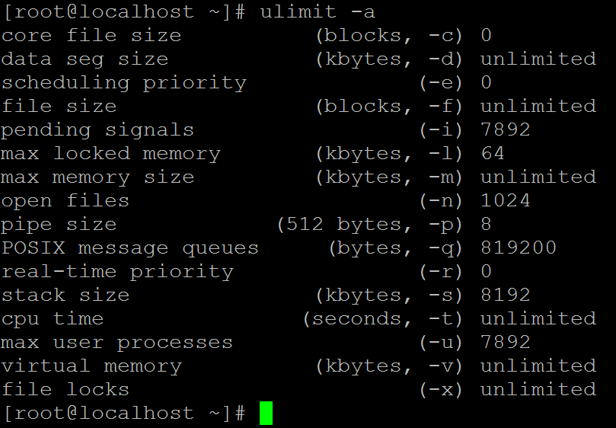
Resource Limits
The OS imposes limits for certain system resources it can use.
Applicable to a specific process.
The “ulimit” shell built-in can be used to set/query the status.
“ulimit –a” returns the user limit values

Slide 119
Hard and Soft Limits
-c → Maximum size of “core” files created.
-f → Maximum size of the files created.
-l → Maximum amount of memory that can be locked using mlock() system call.
-n → Maximum number of open file descriptors.
-s → Maximum stack size allowed per process.
-u → Maximum number of processes available to a single user.
Each resource has two limits –Hard and Soft
Hard Limits
Absolute limit for a particular resource. It can be a fixed value or “unlimited”
Only superuser can set hard limit.
“ulimit” command has –H or –S option to set hard/soft limits. Default is soft limit.
Hard limit cannot be increased once it is set.
Soft Limits
User-definable parameter for a particular resource.
Can have a value of 0 till <hard limit> value.
Any user can set soft limit.
Limits are inherited (the new values are applicable to the descendent processes).

Slide 120
Resource Limitation
getrlimit()/setrlimit() are system-call interfaces for getting and setting resource limits.
Syntax
getrlimit(<resource>, &r)
setrlimit (<resource>, &r)
where r is of type “struct rlimit”
int getrlimit(int resource, struct rlimit *rlim);
int setrlimit(int resource, const struct rlimit *rlim);
int prlimit(pid_t pid, int resource, const struct rlimit *new_limit, struct rlimit *old_limit);
struct rlimit {
rlim_t rlim_cur; /* Soft limit */
rlim_t rlim_max; /* Hard limit (ceiling for rlim_cur) */
};

Slide 121
Resource Usage
struct rusage {
struct timeval ru_utime; /* user CPU time used */
struct timeval ru_stime; /* system CPU time used */
long ru_maxrss; /* maximum resident set size */
long ru_ixrss; /* integral shared memory size */
long ru_idrss; /* integral unshared data size */
long ru_isrss; /* integral unshared stack size */
long ru_minflt; /* page reclaims (soft page faults) */
long ru_majflt; /* page faults (hard page faults) */
long ru_nswap; /* swaps */
long ru_inblock; /* block input operations */
long ru_oublock; /* block output operations */
long ru_msgsnd; /* IPC messages sent */
long ru_msgrcv; /* IPC messages received */
long ru_nsignals; /* signals received */
long ru_nvcsw; /* voluntary context switches */
long ru_nivcsw; /* involuntary context switches */
};
int getrusage(int who, struct rusage *usage);
getrusage() returns resource usage measures
for who, which can be one of the following:
RUSAGE_SELF
RUSAGE_CHILDREN
RUSAGE_THREAD
sysconf - get configuration information at
run time:
long sysconf(int name);
Example: ret= sysconf(_SC_CLK_TCK);
On success it returns the value of the given system limits.

Slide 122
Multi Threading
Thread is a sequential flow of control through a program.
If a process is defined as a program in execution then a thread is defined as a function in execution.
If a thread is created, it will execute a specified function.
Two type of threading: 1. Single Threading and 2. Multi threading
The created threads within a process share 1. instructions of a process 2. process address space and data 3. open file descriptors 4. Signal Handlers 5. pwd, uid and gid
The created threads maintain it’s own
1. thread identification number (tid); 2. pc, sp, set of registers 3. stack
4. priority of the threads
5. scheduling policy
Advantages of Threads:
Takes less time for creation of a new thread, termination of a thread and communication between threads are easier.

Slide 123

Advantages
Improve application responsiveness
Use multiprocessors more efficiently
Improve program structure
use fewer system resources
Specific applications in uniprocessor machines
Applications
A file server on a LAN
GUI
web applications
Display on monitor
Kernel
Auto Saving
Input from keyboard

Slide 124
Thread Creation
#include <pthread.h>
void thread_func(void) { printf(“ Thread id is %d”, pthread_self()); }
main ( ) {
pthread_t mythread; pthread_create ( &mythread, NULL, (void *) thread_func, NULL);
}
This needs to be compiled as follows...$gcc pthread.c –lpthread
pthread_t is type-defined as unsigned long int. It takes the thread address as the first argument, the second argument is used to set the attributes for the thread-like stack size, scheduling policy, priority; if NULL is specified, then it takes default values for the attributes.
The third argument is the function that the thread should execute when created. The fourth argument is the argument for the thread function. If that function has a single argument to be passed, we can specify it here. If it has more than one argument, then we have to use a structure and declare all the arguments and pass the address of the structure.

Slide 125
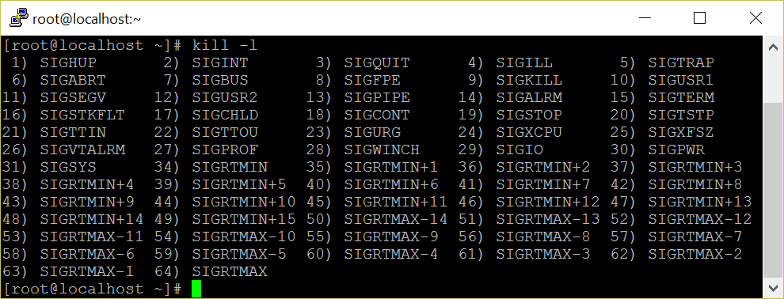
Linux Signals

Slide 126
Introduction
Signals are a fundamental method for inter process communication and are used in everything from network servers to media players.
A signal is generated when
an event occurs (timer expires, alarm, etc.,)
a user quota exceeds (file size, no of processes etc.,)
an I/O device is ready
encountering an illegal instruction
a terminal interrupt like Ctrl-C or Ctrl-Z.
some other process send ( kill -9 pid)
Each signal starts with macro SIGxxx.
Each signal may also specifies with its integer number
For help: $ kill –l , $ man 7 signal
When a signal is sent to a process, kernel stops the execution and "forces" it to call the signal handler.
When a process executes a signal handler, if some other signal arrives the new signal is blocked until the handler returns.

Slide 127
Signal Vs Interrupt
Interrupt
Signal
Process
Process
Process
Kernel
Kernel
Kernel
process
Illegal instruction
Hard ware
$ kill -9 pid
I/O operation (ex: mouse click)

Slide 128
signal System Call
How a process receives a signal, when it is
executing in user mode
executing in kernel mode
not running
in interruptible sleep state
in uninterruptible sleep state
When a signal occurs, a process could
Catch the signal
Ignore the signal
Execute a default signal handler
Two signals that cannot be caught or ignored
SIGSTOP
SIGKILL
signal system call is used to catch, ignore or set the default action of a specified signal.
int signal (int signum, (void *) handler);
It takes two arguments: a signal number and a pointer to a user-defined signal handler.
Two reserved predefined signal handlers are :
SIG_IGN
SIG_DFL

Slide 129
signal System Call
sigaction ( ) is ame as signal( ) but it has lot of control over a given signal.
The syntax of sigaction is:
int sigaction ( int signum, const struct sigaction *act, struct sigaction *oldact);
signum, is a specified signal
act is used to set the new action of the signal signum;
oldact is used to store the previous action, usually NULL.
Kill system call is used to send a given signal to a specific process
int kill ( pid_t process_id, int signal_number );
it accepts two arguments, process ID and signal number
If the pid is positive, the signal is sent to a particular process.
If the pid is negative, the signal is sent to the process whose group ID matches the absolute value of pid.

Slide 130
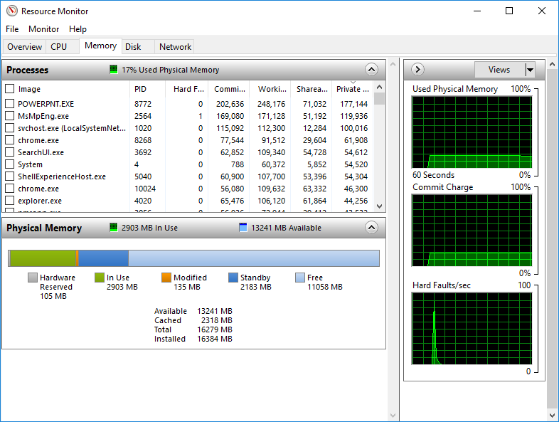
Memory Management

Slide 131
Virtual Memory
Large address space: virtual memory is many times larger than the physical memory in a system.
For a 32 bit OS, the virtual memory size will be 2 to the power of 32 i.e 4GB. But the RAM size may be much smaller.
Each process has a separate virtual address space.
Each process space is protected from other processes.
It supports shared virtual memory, i.e more than one process can share a shared page.
Uses paging technique.
Memory management: one of the most important kernel subsystems
Virtual Memory: Programmer need not to worry about the size of RAM (Large address space)
Static allocation: internal Fragmentation
Dynamic allocation: External Fragmentation
Avoid Fragmentation: Thrashing -overhead

Slide 132
Dynamic Allocation
Physical Memory
Stage 1
Stage 2
Thrashing
Kernel Space
Kernel Space
Kernel Space
Kernel Space
User Space
P1
P6
P6
P2
P7
P7
P3
P8
P3
P3
P4
P8
P9
P5
P9

Slide 133
Static Allocation
Physical Memory
Stage 1
Paged Allocation
Kernel Space
Kernel Space
Kernel Space
User Space
P1
P1
P2
P2
P3
P3
P4
P3
P5
P3
P1
P4
P6
P5
P10
P6
P1
P6

Slide 134
Page Table
Translate a process virtual address into physical address since processor use only virtual address space
The size of a page table is normally size of a page
if it is 4kb, each page address size is 4byte, so 1024 page entries in a page table.
holds info about
Whether valid page table or not?
PFN
access control information
Stored in TLB (Translation Look-aside Buffer)
Hard ware support (MMU, TLB) is required.
Fair share allocation
static allocation
Minimize internal fragmentation
identified by a PFN (Page Frame Number)
virtual address is split into two parts namely an offset and a virtual page frame number.

Slide 135
Memory Mapping
Executable image spilt into equal sized small parts (normally a page size)
Virtual memory assigns virtual address to a each part
Linking of an executable image into a process virtual memory
Swapping
Swap space is in hard disk partition
If a page is waiting for certain event to occur, swap it.
Use physical memory space efficiently
If there is no space in Physical memory, swap LRU pages into swap space
Demand Paging - don't load all the pages of a process into memory
Load only necessary pages initially
if a required page is not found, generate page fault then the page fault handler brings the corresponding page into memory.

Slide 136
Kernel Data Structure
Source Code: /usr/src/linux-4.12/mm
/usr/src/linux-4.12/include/linux
virtual memory is represented by an mm_struct data structure
it has pointers to vm_area_struct data structure
created when an executable image is mapped with the process virtual address
has starting and end points of virtual memory
represents a process's image like text, data and stack portion
has control access info
mm_types.h
struct mm_struct {
struct vm_area_struct *mmap; /* list of VMAs */
…………………………………….
struct vm_area_struct {
/* The first cache line has the info for VMA tree walking. */
unsigned long vm_start;
unsigned long vm_end;
/* linked list of VM areas per task, sorted by address */
struct vm_area_struct *vm_next, *vm_prev;
…………………………………….

Slide 137
Virtual to Physical Memory Translation
Process X
Process Y
VPFN 6
VPFN 6
VPFN 5
Process X
page tables
Process Y
page tables
VPFN 5
VPFN 4
PFN 4
VPFN 4
VPFN 3
PFN 3
VPFN 3
VPFN 2
PFN 2
VPFN 2
VPFN 1
PFN 1
VPFN 1
VPFN 0
PFN 0
VPFN 0
Virtual memory
Physical Memory
Virtual memory

Slide 138

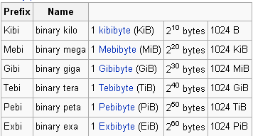


x86-64 Virtual Memory Layout
$pmap –x <pid>
0xFFFF FFFF FFFF FFFF
Kernel Space
128 TiB
0xFFFF 8000 0000 0000
Reserved by hardware
for future expansion
(not to scale)
16 EiB - 256 TiB
0x0000 7FFF FFFF FFFF
User Space
(Application’s code and data)
128 TiB
0x0000 0000 0000 0000

Slide 139
Virtual to Physical Transition
63
47
VIRTUAL PAGE NUMBER
OFFSET
0
RESERVED
36 bits
12 bits
Translation
47
0
36 bits
12 bits
PHYSICAL PAGE NUMBER
OFFSET

Slide 140
Memory Architecture – Page Table
63
47
VIRTUAL PAGE NUMBER
OFFSET
0
RESERVED
36 bits
12 bits
%cr3
36 bits
PAGE TABLE
1
(PTE for the virtual page number)
47
0
36 bits
12 bits
PHYSICAL PAGE NUMBER
OFFSET

Slide 141
Page Table Hierarchy on x86-64
63
47
PML4E
PDPTE
PDE
PTE
OFFSET
0
RESERVED
9 bits
9 bits
9 bits
9 bits
12 bits
512 entry
512 entry
512 entry
512 entry
4096 byte
page global directory
Page middle directory
page directory
page table
page
36 bits
%cr3

Slide 142
Memory Architecture
63
47
VIRTUAL PAGE NUMBER
OFFSET
0
RESERVED
36 bits
12 bits
TLB lookup
Add entry to TLB and continue…
Mapping cached in TLB
Map & load page into RAM
NO
(TLB MISS)
Lookup page in process page table
YES
YES
(TLB HIT
Is page mapped in RAM?
NO
Page Fault
47
0
36 bits
12 bits
PHYSICAL PAGE NUMBER
OFFSET

Slide 143
$ free -m
Memory 8 GB
buffers 30 MB
used
472MB
free
7115 MB
cached
188 MB
 | total | used | free | shared | buffers | cached
Mem: | 7806 | 691 | 7115 | 0 | 30 | 188
-/+ buffers/cache: |  | 472 | 7334
Swap: | 1999 | 0 | 1999
Mem: used = 472 + 30 + 188 = 690

Slide 144
Walk Through Program Execution
Execute
./a.out
Memory
Mapping
P
R
O
C
C
E
S
S
O
R
Virtual
Memory
Demand
paging
Page
Table
VPFN
Page
Table
Load
VPFN
execute
Page Fault
Exit
Swap
Space
Hard
Disc

Slide 145
Overview
of
LINUX Device Drivers

Slide 146
Agenda
Introduction to Device Drivers
Brief Introduction of Linux OS and Its Internals
Classes of Devices
Device Driver Classifications
Kernel Modules Vs Applications
Major and Minor numbers
Device Driver Entry Points
Developing and Compiling a Simple Module
Loading and Removing a Module
Character Device Driver
I/O Memory Allocation
File Structure
File Operations Structure
Transfer of data to / from Device Driver
Design of a Simple Character Device Driver

Slide 147
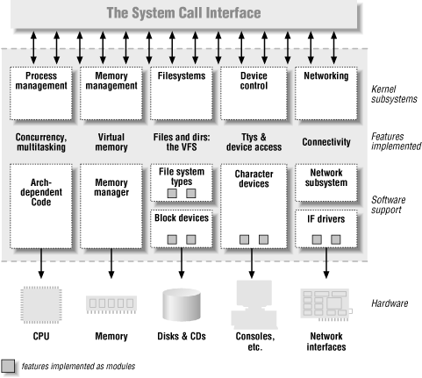
Linux Kernel Architecture

Slide 148
Device Driver Introduction
A device driver is a collection of functions that accept general requests for I/O operations and manipulate the device to perform the requested operations.
Under UNIX every device is managed by device driver functions.
The group of functions is compiled and attached as part of the UNIX kernel.

Slide 149
Device Driver Introduction
Device Drivers are the translators of the unix operating system kernel. They stand between the kernel and peripherals, translating requests for work into activity by the hardware.
A device driver is a “C’ program that controls a device.
Drivers are distinct "black boxes" that make a particular piece of hardware respond to a well-defined internal programming interface.

Slide 150
Device Driver Classifications
Statically linked driver: whose object code is linked with the kernel. The code of such device driver is physically contained in the kernel and therefore loaded in memory when the system boots.
Dynamically linked driver: whose object code is NOT linked with the kernel. The code of such device driver is NOT contained in the kernel, and the device driver is loaded and unloaded as and when required.

Slide 151
Fundamental Concept
Write kernel code to access the hardware, but don't force particular policies on the user, since different users have different needs.
The driver should deal with making the hardware available, leaving all the issues about how to use the hardware to the applications.
The kernel is non preemptive. Kernel functions do not get context switched. Thus, you need not do lots of messy locking on variables.
But, if one of the driver routines goes into an infinite loop, the machine will hang. If the routine takes too long, the machine will appear to pause.
None of the libc functions are available, but some of them are duplicated.

Slide 152
Kernel Modules Vs Applications
Applications performs a single task from beginning to end, A module registers itself in order to serve future requests.
Application call functions resolves external references using appropriate lib functions during link stage, whereas modules are linked only to the kernel, and only functions it can call are exported by kernel.
Since no library is linked to modules, source file should never include usual header files.
Segmentation fault is harmless during application development but kernel fault is fatal at least to the current process, if not for the whole system.

Slide 153
Kernel Modules Vs Applications
User activities are performed by means of a set of standardized calls that are independent of the specific driver.
Mapping those calls to device-specific operations that act on real hardware is then the role of the device driver.
However, unlike a C program, you do not link a device driver into an executable program as it does not have a main() function - meaning that a device driver does not have a single entry point.

Slide 154
Namespace Pollution
Kernel programmer must be aware of and avoid namespace pollution.
The programmer is to find unique names for new symbols.
Namespace collisions can lead module loading failures.
The best approach for preventing namespace pollution is to declare all your global variables as static.

Slide 155
Major and Minor Numbers
A driver never actually knows the name of the device being opened, just the device number—and users can play on this indifference to names by aliasing new names to a single device for their own convenience.
If you create two special files with the same major/minor pair, the devices are one and the same, and there is no way to differentiate between them.

Slide 156
Major and Minor Numbers
$ ls -l /dev/hda*
brw-rw---- 1 root disk 3, 0 Mar 24 2001 /dev/hda
brw-rw---- 1 root disk 3, 1 Mar 24 2001 /dev/hda1
brw-rw---- 1 root disk 3, 2 Mar 24 2001 /dev/hda2
$ ls –l /dev/lp*
crw-rw---- 1 root lp 6, 0 Mar 24 2001 lp0
crw-rw---- 1 root lp 6, 1 Mar 24 2001 lp1
crw-rw---- 1 root lp 6, 2 Mar 24 2001 lp2

Slide 157
Current Process Information
#include <linux/sched.h>
One of the most important header files.
struct task_struct *current;
The current process.
for ex: current - > pid; current - > comm; etc,.
The process ID and command name for the current process.
MODULE_AUTHOR (“ Linus Torvald ”);
Puts the author’s name into the object file.
MODULE_DESCRIPTION (“simple character device driver”);
Puts a description of the module into the object file.
$modinfo –a module.o : To check author name.
$modinfo –d module.o : To check module description.

Slide 158
Dynamic Memory Allocation
- obtains a memory area using kmalloc and releases it using kfree.
- behave like malloc except takes an additional argument, the priority.
- usually, a flag of GFP_KERNEL or GFP_ATOMIC or GFP_USER.
void *kmalloc (unsigned int size, int priority);
void kfree (void *obj);

Slide 159
Driver Entry Points
A device driver has a collection of functions known as entry points. Some of the entry points are :
open()
release()
llseek()
read() (used for character device drivers only)
write() (used for character device drivers only)
strategy() (used for block device drivers only)
ioctl ()
poll()

Slide 160
Input-Output Interface
open()
close()
read()
write()
ioctl()
Linux kernel interface
Based on the “path”, identify the device.
Call the corresponding device function
Device1
D_open1
D_close1
D_read1
D_write1
D_ioctl1
Device2
D_open2
D_close2
D_read2
D_write2
D_ioctl2
Device3
D_open3
D_close3
D_read3
D_write3
D_ioctl3
Device4
D_open4
D_close4
D_read4
D_write4
D_ioctl4

Slide 161
Developing and Compiling a Simple Module
Need root permission to load or remove the module.
$insmod ./char.o
Module Insertion Successful.
$rmmod char
Module unloading Successful.
Output of printk is shown because, after loading the module it can link to the kernel and can access the kernel's public symbols (functions and variables).
#include <linux/kernel.h>
int my_init (void)
{
printk ("Module Insertion Successful\n");
return 0;
}
void my_cleanup (void)
{
printk ("Module unloading Successful \n");
}
module_init (my_init);
module_exit (my_cleanup);

Slide 162
$lsmod
whether the module is loaded or not can be checked by
$cat /proc/modules (or) lsmod
Module Size No.of User
nfsd 69696 8
------ ------ ---
usbcore 49664 1
$cat /proc/devices
Character devices:
1 mem
----
10 misc
Block devices:
1 ramdisk
2 fd

Slide 163
Switch Table
The Unix kernel maintains a set of data structures known as : Switch Table
These data structures are used to locate and invoke the entry points of a device driver.
Each switch table is an array of structures. Each structure contains a number of function pointers.

Slide 164
Locating Driver Entry Points
To decide which element of the switch table should be used, the system uses the “major device number”.
Then the system decides which entry point of the element should be used.
This depends upon the system call used by the process. If the process used “open” system call, then the “open” entry point is used and so on...

Slide 165
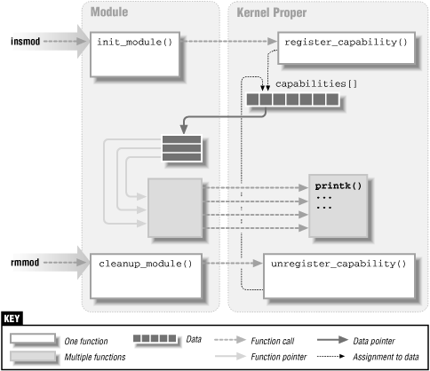

Slide 166
Device Registration
The init ( ) is called when the device driver is loaded in memory.
Registers other entry points of the driver with the kernel.
Registers the resources like major number, IRQ, IO ports etc., which are needed by the driver with the kernel.
int init_module ( ) {
register device;
}
int register_chrdev (unsigned int major, const char *name, struct file_operations *fops);
Some of the numbers such as 60 – 63, 120 - 127 and 240 – 254 are not used for the standard devices, and used for experimental purpose.

Slide 167
cleanup_module ( )
void cleanup_module ( ) {
unregister the device and release the major number;
}
int unregister_chrdev (unsigned int major, const char *name);
struct file, defined in <linux/fs.h>, is the most important data structure used in device drivers.
The file structure represents an open file. It is not specific to device drivers, every open file in the system has an associated struct file in kernel space.

Slide 168
File Structure
It is created by the kernel on open and is passed to any function that operates on the file, until the last close. After all instances of the file are closed, the kernel releases the data structure.
struct file {
struct file_operations *f_op;
unsigned int f_flags;
mode_t f_mode;
loff_t f_pos;
void *private_data;
………………………………..
};

Slide 169
File Structure
mode_t f_mode
The file mode identifies the file as either readable or writable (or both).
loff_t f_pos
The current reading or writing position.
unsigned int f_flags
A driver needs to check the flag for non blocking operation. The flags are defined in the header <linux/fcntl.h>.

Slide 170
File Structure
struct file_operations *f_op
The operations associated with the file.
void *private_data
The driver is free to make its own use of the field or to ignore it. The driver can use the field to point to allocated data, but then must free memory in the release method.

Slide 171
file_operations Structure
An open device is identified internally by a file structure, and the kernel uses the file_operations structure to access the driver’s functions. The structure, defined in <linux/fs.h>, is an array of function pointers.
Each file is associated with its own set of functions The operations are mostly in charge of implementing the system calls such as open, read, llseek, and so on.
The file_operations structure has been slowly getting bigger as new functionality is added to the kernel.

Slide 172
file_operations Structure
struct file_operations fops = {
lseek,
read,
write,
readdir
select / poll
ioctl
open,
flush
release
};

Slide 173
file_operations Structure
The following list shows what operations appear in struct file_operations for the 2.4 series of kernels. The return value of each operation is 0 for success or a negative error code to signal an error.
loff_t (*llseek) (struct file *, loff_t, int);
The llseek method is used to change the current read/write position in a file. The loff_t is a “long offset”.
ssize_t (*read) (struct file *, char *, size_t, loff_t *);
used to retrieve data from the device. A non-negative
return value represents the number of bytes successfully read.
ssize_t (*write) (struct file *, const char *, size_t, loff_t *);
sends data to the device. The return value, if non-negative,
represents the number of bytes successfully written.

Slide 174
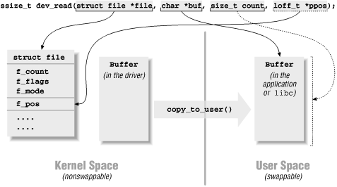
read for example

Slide 175
file_operations Structure
int (*readdir) (struct file *, void *, filldir_t);
This field should be NULL for device files; it is used for reading directories, and is only useful to file systems.
unsigned int (*poll) (struct file *, struct poll_table_struct *);
The poll method is the back end of two system calls, poll and select, both used to inquire if a device is readable or writable. Either system call can block until a device becomes readable or writable.
int (*ioctl) (struct inode *, struct file *, unsigned int cmd, unsigned long arg);
The ioctl system call offers a way to issue device-specific commands (like Formatting a track of a floppy disk, which is neither reading nor writing).

Slide 176
file_operations Structure
int (*mmap) (struct file *, struct vm_area_struct *);
mmap is used to request a mapping of device memory to a process’s address space.
int (*open) (struct inode *, struct file *);
When a device file is open, this entry point is called.
int (*flush) (struct file *);
The flush operation is invoked when a process closes its copy of a file descriptor for a device; Currently, flush is used only in the network file system (NFS) code.
int (*release) (struct inode *, struct file *);
This operation is invoked when the file structure is being released. Like open, release can be missing.*

Slide 177
Driver Kernel Communication
Any device operation is typically initiated by a process.
For example a process might use the read() system call to read 10 bytes for a file opened earlier, and store these 10 bytes in a local buffer.
The read() system call now finds out which device is associated with this request, the type of the device and the major device number associated with the device.
The read() system call then invokes the read() entry point of the device and supplies the address of the user (process) buffer to the device driver.
However, the user buffer is located in the process address space. Whereas the device driver executes in the kernel address space.

Slide 178
Transfer of Data To/From Drivers
To copy from user buffer to kernel buffer vice versa can be done by the following functions.
unsigned long copy_to_user(void *to, const void *from, unsigned long count);
unsigned long copy_from_user(void *to, const void *from, unsigned long count);

Slide 179
Device File Creation
The command to create a device node on a filesystem is mknod;
Superuser privileges are required for this operation. The command takes three arguments in addition to the name of the file being created. For example, the command
mknod /dev/dev1 c 254 0
creates a char device (c) whose major number is 254 and whose minor number is 0.
Note that once created by mknod, the special device file remains unless it is explicitly deleted.

Slide 180
Thank You

